Slide 1
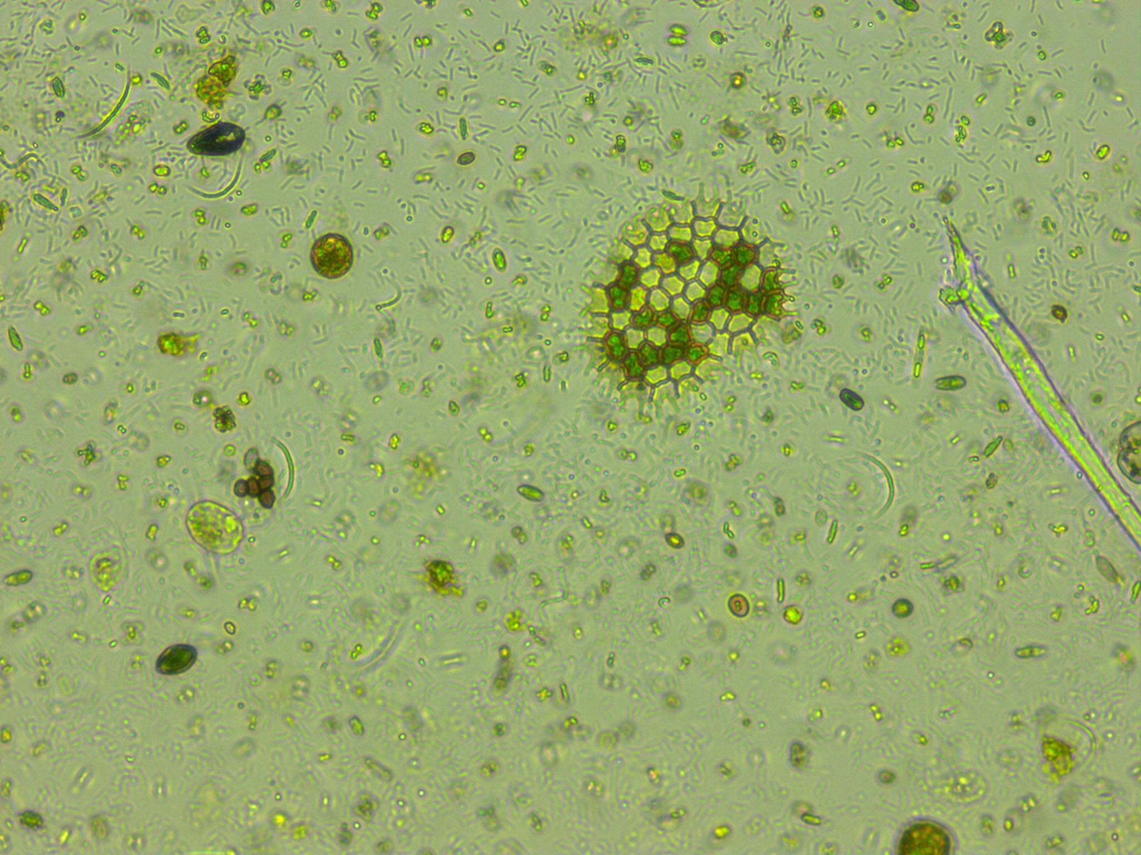
Predicting phytoplankton metabolism from the individual size distribution
Daniel Padfield

Slide 2
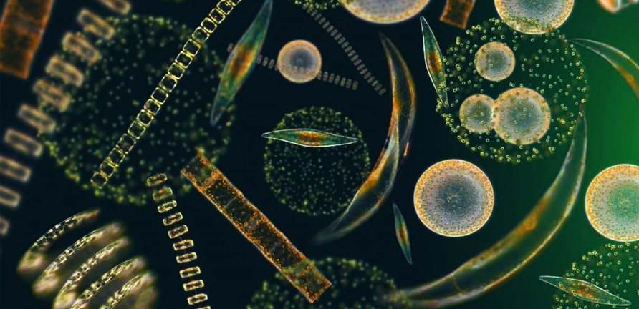
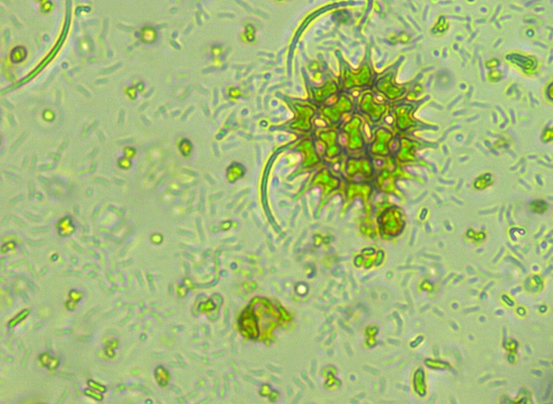
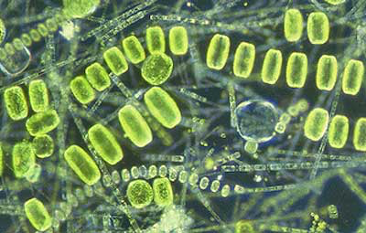
Phytoplankton are key for the carbon cycle
~50% of annual carbon fixation
Fuel entire ocean food webs

Slide 3
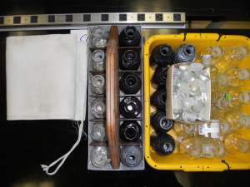
Current measurements of metabolism
Bottle incubations – in vivo

Slide 4
Could metabolic theory fill the gap?
Links metabolic rate to environmental temperature and body size
Successfully used before

Slide 5
Crash course in metabolic theory

Slide 6
Crash course in metabolic theory

Slide 7
Zero-sum dynamics

Slide 8
Microbial metabolic theory

Slide 9
Experimental setup

Slide 10
Analysis

Slide 11
Long-term warming changes communities

Slide 12
No difference in measured raw metabolism

Slide 13
Model predicts size and temperature-dependence

Slide 14
Model does a pretty good job!

Slide 15
Paradoxical result?

Slide 16
Zero-sum dynamics

Slide 17
Zero-sum dynamics
Slope =
Not significantly different from -1

Slide 18
Zero-sum dynamics
Slope =
Not significantly different from -1
Slope =
Not significantly different from -1

Slide 19
This can be useful – metabolic theory is great

Slide 20
Thanks for listening!

